Slide 1
Clinical Tools Working with Dissociative Disorders and Plural Communities
By. Dr. Serseción they/them
SerenitySersecionPhD@gmail.com

Slide 2
About Me
Clinical Psychologist
Gender queer
They/Them/Ellos
Puerto Rican
English second language speaker
Worked with the LGBTQ+ and Plural / DID communities through entire career

Slide 3
DIAGNOSIS DSM 5

Slide 4
Dissociative Diagnosis
Dissociative disorders are characterized by a disruption of and/or discontinuity in the normal integration of consciousness, memory, identity, emotion, perception, body representation, motor control, and behavior.
Dissociative symptoms can potentially disrupt every area of psychological functioning.
Often caused by traumatic experiences.
Potential diagnosis are dissociative identity disorder (DID), dissociative amnesia, depersonalization/derealization disorder, other specified dissociative disorder (OSDD), and unspecified dissociative disorder.
DSM 5 American Psychiatric Association (APA), 2013

Slide 5
Dissociative Diagnosis
Dissociative Identity Disorder 300.14 (F44.81)
Disruption of identity characterized by two or more distinct personality states, which may be described in some cultures as an experience of possession.
The disruption in identity involves marked discontinuity in sense of self and sense of agency, accompanied by related alterations in affect, behavior, consciousness, memory, perception, cognition, and/or sensory-motor functioning.
These signs and symptoms may be observed by others or reported by the individual.
Recurrent gaps in the recall of everyday events, important personal information, and/or traumatic events that are inconsistent with ordinary forgetting.

Slide 6
Dissociative Diagnosis
DID continued.
The symptoms cause clinically significant distress or impairment in social, occupational, or other important areas of functioning.
The disturbance is not a normal part of a broadly accepted cultural or religious practice.
Note: In children, the symptoms are not better explained by imaginary playmates or other fantasy play.
The symptoms are not attributable to the physiological effects of a substance (e.g., blackouts or chaotic behavior during alcohol intoxication) or another medical condition (e.g., complex partial seizures)

Slide 7
Dissociative Diagnosis
Dissociative Amnesia 300.12 (F44.0)
An inability to recall important autobiographical information, usually of a traumatic or stressful nature, that is inconsistent with ordinary forgetting.
Note: Dissociative amnesia most often consists of localized or selective amnesia for a specific event or events; or generalized amnesia for identity and life history.
The symptoms cause clinically significant distress or impairment in social, occupational, or other important areas of functioning.

Slide 8
Dissociative Diagnosis
Dissociative Amnesia continued.
The disturbance is not attributable to the physiological effects of a substance, or a neurological or other medical condition, or other neurological condition).
The disturbance is not better explained by dissociative identity disorder, posttraumatic stress disorder, acute stress disorder, somatic symptom disorder, or major or mild neurocognitive disorder.
300.13 (F44.1) With dissociative fugue: Apparently purposeful travel or bewildered wandering that is associated with amnesia for identity or for other important autobiographical information.

Slide 9
Dissociative Diagnosis
Depersonalization/Derealization Disorder 300.6 (F48.1)
The presence of persistent or recurrent experiences of depersonalization, derealization, or both:
Depersonalization: Experiences of unreality, detachment, or being an outside observer with respect to one’s thoughts, feelings, sensations, body, or actions (e.g., perceptual alterations, distorted sense of time, unreal or absent self, emotional and/or physical numbing).
Derealization: Experiences of unreality or detachment with respect to surroundings (e.g., individuals or objects are experienced as unreal, dreamlike, foggy, lifeless, or visually distorted).

Slide 10
Dissociative Diagnosis
Depersonalization/Derealization continued.
During the depersonalization or derealization experiences, reality testing remains intact.
The symptoms cause clinically significant distress or impairment in social, occupational, or other important areas of functioning.
The disturbance is not attributable to the physiological effects of a substance (e.g., a drug of abuse, medication) or another medical condition (e.g., seizures).
The disturbance is not better explained by another mental disorder, such as schizophrenia, panic disorder, major depressive disorder, acute stress disorder, posttraumatic stress disorder, or another dissociative disorder.

Slide 11
Dissociative Diagnosis
Other Specified Dissociative Disorder 300.15 (F44.89)
This category applies to presentations in which symptoms characteristic of a dissociative disorder that cause clinically significant distress or impairment in social, occupational, or other important areas of functioning predominate but do not meet the full criteria for any of the disorders in the dissociative disorders diagnostic class.
Examples:
Chronic and recurrent syndromes of mixed dissociative symptoms:
Identity disturbance associated with less-than-marked discontinuities in sense of self and agency, or alterations of identity or episodes of possession in an individual who reports no dissociative amnesia.

Slide 12
Dissociative Diagnosis
OSDD Continued.
Identity disturbance due to prolonged and intense coercive persuasion:
Individuals who have been subjected to intense coercive persuasion (e.g., brainwashing, thought reform, indoctrination while captive, torture, long-term political imprisonment, recruitment by sects/cults or by terror organizations) may present with prolonged changes in, or conscious questioning of, their identity.
Acute dissociative reactions to stressful events:
Acute, transient conditions that typically last less than 1 month, and sometimes only a few hours or days. These conditions are characterized by constriction of consciousness; depersonalization; derealization; perceptual disturbances (e.g., time slowing, macropsia); micro-amnesias; transient stupor; and/or alterations in sensory-motor functioning (e.g., analgesia, paralysis).

Slide 13
Dissociative Diagnosis
OSDD continued
Dissociative trance:
This condition is characterized by an acute narrowing or complete loss of awareness of immediate surroundings that manifests as profound unresponsiveness or insensitivity to environmental stimuli. The unresponsiveness may be accompanied by minor stereotyped behaviors (e.g., finger movements) of which the individual is unaware and/or that he or she cannot control, as well as transient paralysis or loss of consciousness. The dissociative trance is not a normal part of a broadly accepted collective cultural or religious practice.

Slide 14
Dissociative Diagnosis
Unspecified Dissociative Disorder 300.15 (F44.9)
This category applies to presentations in which symptoms characteristic of a dissociative disorder that cause clinically significant distress or impairment in social, occupational, or other important areas of functioning predominate but do not meet the full criteria for any of the disorders in the dissociative disorders diagnostic class.
The unspecified dissociative disorder category is used in situations in which the clinician chooses not to specify the reason that the criteria are not met for a specific dissociative disorder and includes presentations for which there is insufficient information to make a more specific diagnosis (e.g., in emergency room settings).

Slide 15
Differential Diagnosis
Posttraumatic Stress Disorder (PTSD)
309.81 (F43.10)
Exposure to actual or threatened death, serious injury, or sexual violence
Presence of one (or more) intrusion symptoms associated with the traumatic event(s), beginning after the traumatic event(s) occurred.
Dissociative reactions (e.g., flashbacks) in which the individual feels or acts as if the traumatic event(s) were recurring. (Such reactions may occur on a continuum, with the most extreme expression being a complete loss of awareness of present surroundings.)
Persistent avoidance of stimuli associated with the traumatic event(s), beginning after the traumatic event(s) occurred.

Slide 16
Differential Diagnosis
PTSD Continued
Negative alterations in cognitions and mood associated with the traumatic event(s), beginning or worsening after the traumatic event(s) occurred, as evidenced by two (or more) of the following (listed dissociative sxs)
Inability to remember an important aspect of the traumatic event(s) (typically due to dissociative amnesia and not to other factors such as head injury, alcohol, or drugs)
Feelings of detachment or estrangement from others.
Persistent inability to experience positive emotions (e.g., inability to experience happiness, satisfaction, or loving feelings).
Marked alterations in arousal and reactivity associated with the traumatic event(s), beginning or worsening after the traumatic event(s) occurred, as evidenced by two (or more) sxs.

Slide 17
Differential Diagnosis
PTSD with dissociative symptoms:
The individual’s symptoms meet the criteria for posttraumatic stress disorder, and in addition, in response to the stressor, the individual experiences persistent or recurrent symptoms of either of the following:
Depersonalization: Persistent or recurrent experiences of feeling detached from, and as if one were an outside observer of, one’s mental processes or body (e.g., feeling as though one were in a dream; feeling a sense of unreality of self or body or of time moving slowly).
Derealization: Persistent or recurrent experiences of unreality of surroundings (e.g., the world around the individual is experienced as unreal, dreamlike, distant, or distorted).

Slide 18
Definitions & TERMS

Slide 19
Theories regarding causes of dissociation
Dissociation can be a way to protect someone.
A rest or break from reality, especially from traumatic experiences.
Can help person live life separate from traumatic experiences.
Person may be unable to process something, and the result is dissociation and/or fragmentation.
Endogenic System / Natural Plurality or Natural Multiplicity:
System that was born plural and/or who believes this
is their natural state.
Plurality:
Healthy multiplicity aka non disordered.
Trauma Based System:
System who believes their multiplicity/plurality comes from traumatic experiences.
Any type of system may have experienced severe trauma, regardless of origin.
Singlet:
Term used for non-plurals / one person in one body.

Slide 20
Definitions
System: Multiple people sharing one body.
Host: Person out the most, can be more than one person.
Some system do not have a host.
Fronting: Person outside at the moment.
Can also be more than one person (co-fronting)
Age-Sliding: Someone who moves from one age to another. At times due to being triggered but may have other causes.
Blurring: Loss of identity for those fronting due to multiple people being out at once and having difficulty telling who is who.
Also, may be due to increased dissociation or stress.

Slide 21
Plural / DID Terms
Plurality:
Healthy multiplicity aka non disordered.
Or an umbrella term for all systems
Or a term outside of the DSM/psychiatric community similar to gender terms outside of the binary
Singlet:
Term used for non-multiples / one person in one body.
Origin of system:
There are various origins of systems which are debated in communities and in the psychiatric/psychological community.
We are focusing on systems as a whole and not a specific type of origin

Slide 22
Singletsona
A singletsona is the “persona” a system presents to the world as a singlet version of themselves.
Sometimes this can be one or a few people in the system
Other times it’s a new “persona” or mask in which system members agree to try and act in a specific way
There are many ways to have a singletsona

Slide 23
What does a system look like internally?
Can be very different.
Some examples:
A stage
A house
A room
Towns, and cities
Forests, lakes, fields.
Many other options

Slide 24
How are people out? (Fronting)
For example, in the stage internal world perhaps the person or people out are “in the spotlight” internally.
For the house example, someone may “exit the house” to be out.
Varies greatly by system
Other reasons why someone is out:
Triggers
Positive (wanting a food you like) or negative (trauma)
Wanting to be out for an experience (example toy store, talking to friends).
Or just because!

Slide 25
Understanding the community

Slide 26
Discussion
For singlets, if you were a system…
Would you all be out to friends and family as a system, or would you identify as a “singlet”?
What are the consequences of both options?
How may this affect your daily life?
How would you navigate the world?

Slide 27
BUILDING RAPPORT
Working on helping them feeling safe and able to build trust.
As a system and individually.
Items for kids and teens in the therapy room.
Coloring books, plushies, toys, etc.
Letting clients take the lead regarding when or if they disclose any difficult/traumatic memories.
Also, when asking who is out… How to do this? What do the clients prefer?

Slide 28
MICRO AND MACROAGGRESSIONS
Here are some common problematic comments and behaviors from therapists:
“I want to talk to the ‘real’ one”.
“I’ll only call you by the birth / legal name.”
Silence when anyone other than the “host” is out.
Stating that others in headspace are “imaginary”.
Asking for only one person to come to session and others cannot attend.
Treating kids and teens as if they are adults.

Slide 29
How do you address people in a system
First be respectful of system, treat people as individuals.
Unless the system tells you differently.
Use the terms the system uses for themselves.
Some common terms are alters, headmates, & parts.
Other ways to address each other: by name, siblings, family, cousins, friends, etc.
Similar to singlets, addressing each other based on relationship type.

Slide 30
How to be respectful in treatment
As a clinician address individuals by their name, not only the legal name of the body.
Do not ask “Who’s the real person?” or “Who’s the original person”.
This can be seen as offensive, and many times may not make sense.
If a systems fits into this category, they will tell you.
Remember that our field is pathologizing of this group/community.
Think of your position and power dynamics between you and clients.
Focus on building trust and safety
If with client with DID and someone else comes out, how to ask?
“It is still..?” You can also be honest and say you aren’t sure who is out.
Ask client how to notify you of any change if they can.
Also, check in on how to ask them respectfully in the future.

Slide 31
Media Representation
Pretty bad… often systems are depicted as “murderers” or “violent and unstable” and other terrible examples.
The movie “Split” is an example of this.
Some things discussed in this movie were true making the overall message worse.
For example, some of the dialogue of the psychologist.
YouTube, TikTok, Instagram and other social media has systems discussing their experiences.
Possible to find some good resources for clients.

Slide 32
Community Events
Local meet ups
Meet-ups at larger events such as conferences, pride events and more.
Online meet-ups and groups
Social Media
Reddit
Subreddits such as: plural, DID, OSDD, Tulpas, and more
Discord
Has various groups to pick from
Best to review if the group’s focus fit what you are looking for
Some are exclusive to certain system types or topics
Meet-up Discords exist based on location and overall focus

Slide 33
Pride events
Dissociation Awareness Day March
Day focused on dissociative disorders
Multiplicity May: Entire month of May
Lists of prompts to write or share about each day of the month
Plural Acceptance Week: Mid-July (Power to the Plurals & Plural Events)
Focused on acceptance of all plurals, 2020
Plural Pride Day in July

Slide 34
INTERSECTIONALITY

Slide 35
INTERSECTING IDENTITIES TO CONSIDER
Age
Class
Gender Identity
SES
Race
Ethnicity
Sexual Orientation
Religion
Country of origin
Language(s) Spoken
Body Size
Country you live in
Education
Social Mobility
Parent Status
Access to technology, books, food…
Location of Residence
Physical / Cognitive Ability
Political environment of country of residence
Mental Health
Physical Health

Slide 36
EFFECT OF PRIVILEGE AND MARGINALIZATION
Clinician is in a position of authority
If the client has experienced trauma from an authority figure this may increase projection and transference
New clinicians may not understand or accept being seen as authority figure
This may cause more distress from client’s different understanding of the dynamic

Slide 37
EFFECT OF PRIVILEGE AND MARGINALIZATION
Plural and Dissociative populations are often stigmatized by our profession
This add to the potential distance between a clinician and client
If a clinician is not aware of this dynamic, they may be more likely to perpetuate microaggressions due to inexperience.

Slide 38
DIFFERENCE BETWEEN SYSTEM MEMBERS
System members can be completely different from each other.
Some possible differences:
Gender, sexuality, age, language spoken, body type, clothing style, ideologies, religion, interests and much more.
Do not assume that system members share intersectional identities.
May be more like siblings in that they were raised by the same parents and in the same household but can be very different from each other.

Slide 39
Intersectionality
The intersection of various identities in each individual in the system and the body or system as a whole.
For example, the intersections of race, class, gender, SES, and other identities.
Intersectionality creates systems of overlapping identities which connect to marginalization and privilege.
Can be difficult to identify all the different intersectional identities we each have.
Important to evaluate the intersections between you as a therapist and your clients.

Slide 40
How does gender identity and sexual orientation present in systems?
There may be various different gender identities and sexual orientations in the same system.
Check in with the system about this and if possible, ask for a system list
Use gender neutral language until you know more about each system member

Slide 41
How does gender identity and sexual orientation present in systems?
Work with the system on having this information if they are open about this and feel safe discussing these topics
If not, focus on rapport building first
Do not assume that anyone in the system matches the gender assigned at birth
Also, if someone does, do not assume they are the “real person” or “core”. That may not even exist.

Slide 42
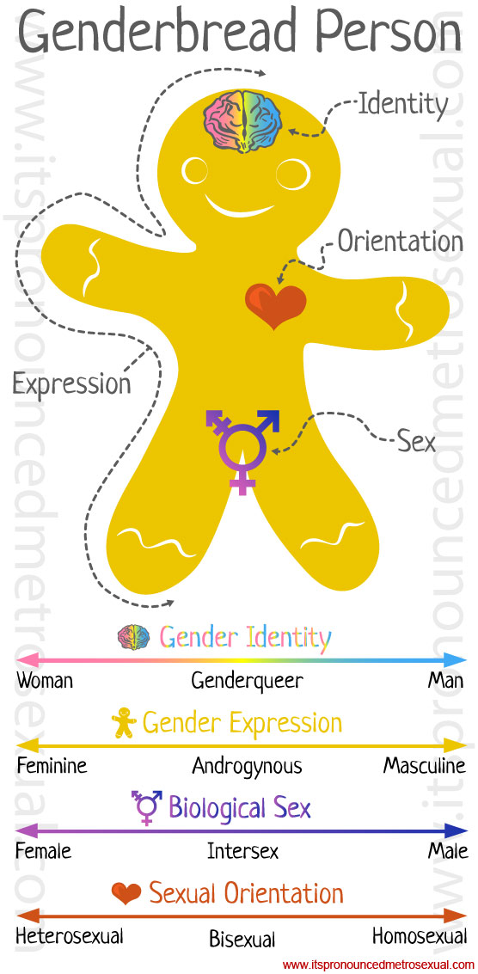
How to explore this…
Gender Identity
Do you feel you are a man,
woman, neither, both?
Gender Expression
How do you present yourself?
Male, female, androgynous?
Biological sex
Refers to genitalia.
Gender assignment at birth.
Sexual Orientation
Who are you attracted to?
Males, females, both, neither

Slide 43
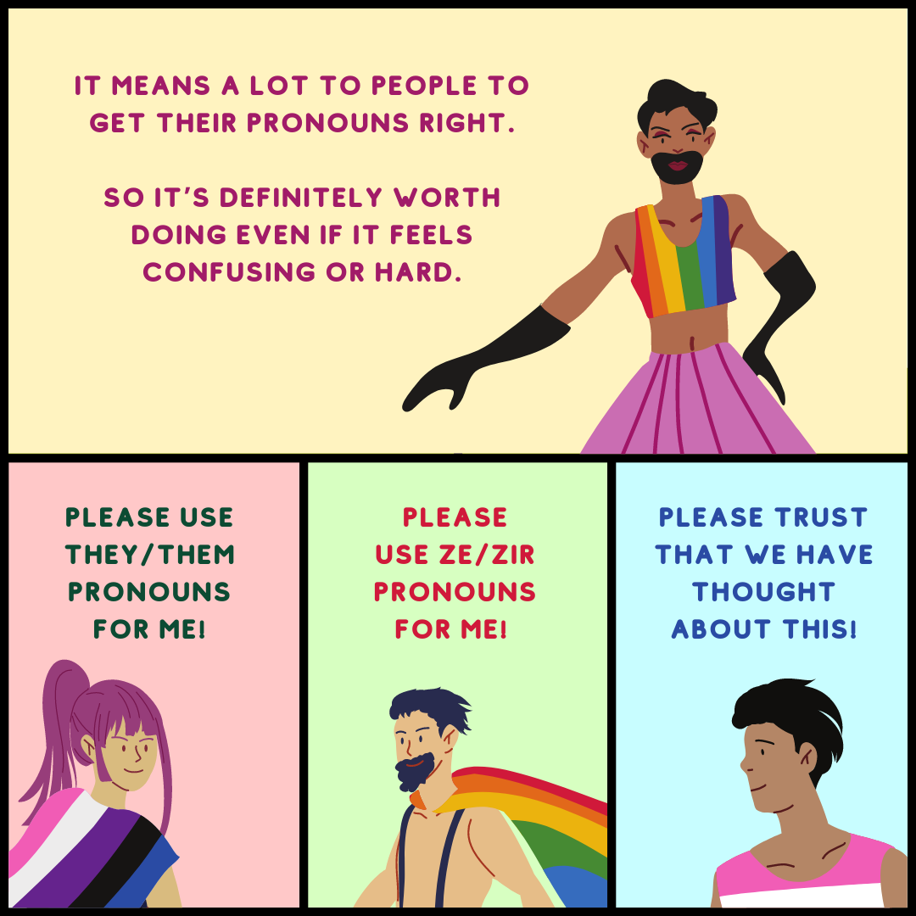
Pronouns
There are different pronouns system members may use.
She/her
He/him
They/them
Or a combination of these
Also, neo pronouns such as:
Ze/zir
Fae/faer
Xe/xir
Some systems use different pronouns for them as a system as opposed to individually.
Incorrect pronoun usage is invalidating and hurtful
Can be seen as denying the individual's reality
Conveying that you are not an ally

Slide 44
Clinical interventions
Break time!

Slide 45
Treatment
Coming into treatment:
Some may not be aware yet of being a system.
Some may be aware but afraid to be open due to stigma, negative experiences with providers, view of psychology towards being plural.
Example: not being real), personal denial and many other reasons.
More often, systems come in for depression, anxiety, trauma, Bipolar, PTSD and other concerns.
Some may want help in communicating, others may think integration is the only way to be healthy.

Slide 46
Treatment
Traditionally integration seen as only alternative.
One metaphor is a vase that breaks due to trauma and the therapist helps glue it back together.
This may be true for some, for others it’s more like multiple vases.
The idea is that through processing trauma people in the system will “no longer be needed” and integrate into one new “complete” person.
However, although some want this, for others it may feel like “death” or “murder of family”.
Being a system is a valid form of living as well, set goals with the clients.

Slide 47
Treatment
Other alternatives for treatment:
Work on co-consciousness, reducing lost time and increasing communication.
Sometimes individuals may join together (fuse or integrate).
Fragments may disappear, but the system remains a system (although possibly smaller).
Switching is purposeful, does not happen unintentionally or rarely.
Help the system learn more grounding tools and ways to communicate internally and externally.

Slide 48
WHAT DOES PLURAL POSITIVE MEAN?
Focus on the entire plural community.
Regardless of origin (traumagenic, endogenic, quoigenic).
Clients decide on goals.
Clinicians should express their assessment and potential goals but these need to be agreed upon with clients.
Integration is not the main focus.
Integration in the clinical sense refers to becoming a singlet.
One person = everyone combined.
Instead, communication within system members is a focus.

Slide 49
WHAT DOES PLURAL POSITIVE MEAN?
If there are blackouts, lost time, or conflicts within the system, these need to be addressed first.
If there is trauma, teaching coping mechanisms and then working on processing.
Helping relationship and communication between system members if needed.
Also, practical concerns such as scheduling fronting time, taking care of tasks internally and externally, anything else important to the system.

Slide 50
WHEN PLURALITY ISNT THE FOCUS OF TREATMENT
Many therapists assume that if someone is plural, that is the focus of treatment.
As a therapist you may think that the goals are completely connected to plurality, ignoring other concerns.
Therapists should be open to the clients’ goals and not assume plurality is the “problem”.
& understanding that the problem may be being plural in a singlet world.

Slide 51
BEING IN THERAPY AS A PLURAL SYSTEM
Work on your goals as a system, everyone should be heard when decision making.
Who will be out at session and when?
This may not be possible to control or agree on yet.
However, if it is, then deciding if anyone needs therapy more urgently.
For example, SI, more flashbacks, new to the system or time.
Sometimes people feel safer being co-con with others.
Especially important for kids, teens or anyone who feels vulnerable.
If possible, explain this to the therapist as well.

Slide 52
BEING IN THERAPY AS A PLURAL SYSTEM
Does anyone have concerns or fears about the therapist?
Can they discuss this with the therapist directly, or someone else in the system?
Have calming items for different people during session.
Some therapists will have calming items in session.
If they know who is out, they may be able to make these more accessible or give “permission” for those who may need this affirmation.
Are there triggers which would be important for the therapist to know about?
Only if you all feel safe providing this information.

Slide 53
Grounding Bag / Kit
First work on grounding overall
Provide psychoeducation about this and the connection to dissociation and trauma
Work with system on having items everyone feels grounded by
In smaller systems you can have one per system member
In larger system focus on things many people or everyone finds comforting
Should be small enough to carry
Try to have one thing for each sense
For example, tactile, scent, auditory (fidget toy sounds or a playlist) etc.
In a more difficult session make sure the system has this on hand
For in person session, having various grounding and comforting items in the room is especially helpful.

Slide 54
Treatment goal: Increasing coconsciousness and communication
How to manage dissociation in treatment.
Grounding / centering
Noticing triggers, in treatment
Using names of individuals to help them stay present.
All with consent of system and being very transparent about this process.
For people who have experienced trauma they need very concrete and direct communication
This helps reduce anxiety and reduce potential misunderstandings
Remember if people have experienced severe and long term trauma then everyone can be seen as dangerous, and they may not be able to trust their own feelings or reactions.

Slide 55
Treatment goal: Increasing coconsciousness and communication
Check in with the system about potential triggers.
Anything in the room that is changeable?
If not, ways to work around this?
Mindfulness, meditation and other methods can be helpful but…
For some people centering can be more triggering and distressing.
For this reason outside grounding is better
Use the 54321 technique
Make sure to be aware of who is out, do not accidentally trigger someone else or try to force a switch in the system.
Trying to force a switch is never appropriate unless a client is in danger and even then it’s best to focus on calming them down.

Slide 56
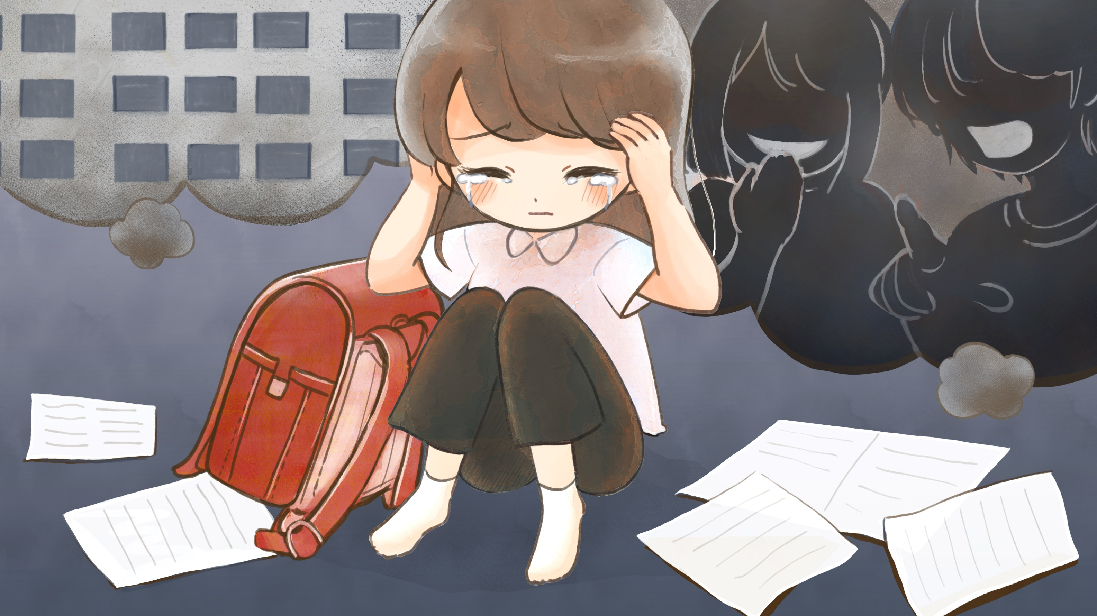
54321 panic technique
When using this you ask the clients to identify…
5 things you can see
4 things you can feel
3 things you can hear
2 things you can smell
1 thing you can taste

Slide 57
Treatment goal: Increasing coconsciousness and communication
For co-consciousness focus on communication, and positive system connection to each other.
Dealing with jealousy.
Past issues between system members
Trauma experiences.
Different needs based on intersectional identities such as personality, age, gender, sexual orientation, etc.

Slide 58
Treatment goal: Increasing coconsciousness and communication
Communication methods:
Leaving notes for each other
Post-its, discord, etc.
Using a shared journal
Talking to trusted people outside that are consistent and can relay information.
Using online chat or private forums to communicate with each other.

Slide 59
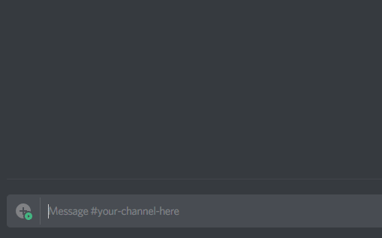
Using Discord for System Communication
There are other chat programs and servers, but discord is free and the easiest to utilize.
Discord is a chat program which is free and allows for private servers
Systems can have a private chat or a full server with various rooms and locations
Some utilize one room as a place to post rules and may divide the server similar to the way headspace is organized
Plural kit is added into a server and allows for systems to express themselves better

Slide 60
Treatment goal: Increasing coconsciousness and communication
Art
Drawing themselves
Drawing other system members
Drawing parts of headspace
Showing relationships between people
Processing trauma and more

Slide 61
How does treatment change with each individual in the system?
Child clients with adult focused therapists.
You will have to learn how to provide treatment for children and teens in order to provide appropriate therapeutic treatment.
Different dx, sxs and therapeutic goals
What dx does each individual have?
What are their sxs?
What are goals for the system as a whole and each system member?

Slide 62
How does treatment change with each individual in the system?
Due to various different needs, notes are very important in order to keep track of everything
It’s best to identify who is out at session, what was worked on
What items affect some system members more than others
Also discussing confidentiality
Similar to family therapy or couples, you cannot keep secrets but you can work on helping people communicate directly or working toward a communication goal
This way you are not complicit in keeping a secret but instead help them reveal things to each other directly.

Slide 63
Tips for therapists
Confidentiality question between people in system.
How will this work?
Does each person want privacy?
Is everyone in agreement that you can share info?
What is and isn’t, ok?
Is there one person (or more) in the system able to hold all info or coordinate care?

Slide 64
System size
How many people do you think there can be in a system?
Are the amount of people linked to trauma?
Avg. of 6 - under 20, but some system have hundreds (polyfragmented).
Also, there may be a difference between people/individuals/alters and fragments.
As a clinician you may only see a small number of people or even just one.
This does not mean the person in session is a singlet.
Building trust and safety will help others in the system feel that they are able to participate in treatment if they want to.

Slide 65
What do you do if someone is against therapy?
Discuss with individual person and the system as a whole about this concern.
What would help them feel safe? (individuals and system)
Would they like to be involved in the future?
For example, someone who does not want to be in therapy now but might later on when there is more trust.
Are they willing to not disrupt others who want therapy?
No sabotaging therapy or causing problems to others who are interested in treatment.

Slide 66
What do you do if someone is against therapy?
Can others speak to this individual internally?
Did this person have a negative experience previously?
Can be helpful to process past trauma or pain in therapy with a new positive relationship?
Are they trying to protect others in the system?
Fear of others getting too close and harming the system.
Important as a therapist to remain stable, compassionate and professional through therapy.

Slide 67
System List
A system list can include names, gender, pronouns, sexuality, interests, goals for therapy and more.
Very useful for knowing the system better
Pronouns are helpful so you can reference this when speaking to system members.
Ask the system to identify themselves when out if possible.
In telehealth may be easier due to using the name in the video chat program as a way to indicate who is out.

Slide 68
System List Example
Marta (she/her):
Cis, female, lesbian, 34 years old, wants to work on depression and is close to Amílcar.
José (he/they):
Transmale, 14 years old, questioning sexuality, wants to work on anxiety. Is close to Amílcar
Esperanza(she/ze):
Transwoman, straight, 43 years old, wants to work on PTSD sxs, does not feel close to most system members.
Paciencia (they/them):
Nonbinary, pansexual, 25 years old, wants to work on anger management, is close to Marta and Esperanza.
Amílcar(he/him):
Cis male, 28 years old, straight, takes care of the children in the system. Wants to work on feeling comfortable taking care of himself instead of always putting others first.

Slide 69
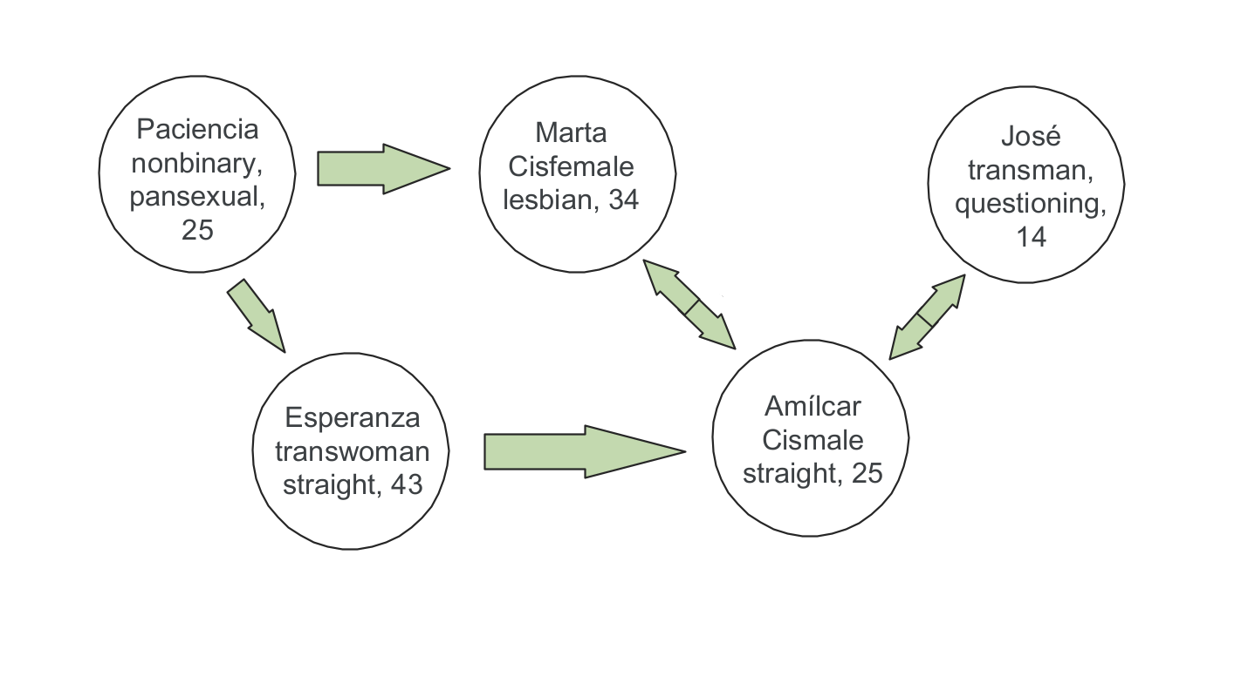
Simple System Map
Focus on individuals in the system
Relationship to each other can be shown with arrows or larger shapes encompassing people.
Also, can have one per person showing how they relate to everyone instead.
Can also use a genogram or similar device for this type of system map.
This example was created with google jam board

Slide 70
Map of headspace
Have the clients either draw a map of all of headspace or pick a portion if that would be too large.
They can focus on locations, houses, topography.
Important to note who lives where, and if locations are based on places in the clients’ life.
Have places changed in the way they look? Or how they feel?

Slide 71
Example of a map with topography and locations
Can show more clearly how headspace looks and where people are located.
This one was created in inkarnate.
Other online programs exist
Or can be done with paper and art supplies

Slide 72
Case presentation

Slide 73
Vignette
You have started to work with a client who says they were recently diagnosed with DID by a different clinician. They want to know the differences between different dissociative disorders to understand their experience better. They are unsure how to process this information and how the diagnosis applies to them.
However, when you speak to them, they discuss various people in the system, always feeling like an “us” since childhood, and having conversations with other “insiders”.
They also wish to pursue gender affirming therapy but are concerned about this diagnosis impacting their ability to get approved. They are unsure of their gender or sexual identity individually and as a system. However, they are AMAB and feel that as a whole they would be more comfortable being able to present as a woman.
They deny any SI/HI or substance use.

Slide 74
Vignette Questions for Discussion
What questions do you have about this case?
What diagnosis would you give this client?
How would you explain the different dissociative diagnosis to this client?
What are your concerns? Any risk factors?
What would be your treatment plan and treatment goals?
How would it be for you to work with this client?

Slide 75
Conferences
An Infinite Mind Healing Together
Systems and therapists, health professionals, etc.
Plural Positivity World Conference
Free, online available for everyone on YouTube, during and after the event.

Slide 76
QUESTIONS?
C
SerenitySersecionPhD@gmail.com

Slide 77
References
American Psychiatric Association. (2013). Diagnostic and statistical manual of mental disorders. (5th ed). Arlington, VA
Astrea (2021). Astraea's Web. Retrieved from http://www.astraeasweb.net/plural/
Apostolidou, Z., & Schweitzer, R. (2017). Practitioners’ perspectives on the use of clinical supervision in their therapeutic engagement with asylum seekers and refugee clients. British Journal of Guidance & Counselling, 45(1), 72–82. https://doi-org.paloaltou.idm.oclc.org/10.1080/03069885.2015.1125852
Bailey, T. D., & Brand, B. L. (2017). Traumatic dissociation: Theory, research, and treatment. Clinical Psychology: Science and Practice, 24(2), 170–185.
Boswell, J., Nelson, D., Nordberg, S., Mcaleavey, A., & Castonguay, L. (2010). Competency in integrative psychotherapy: Perspectives on training and supervision. Professional Psychology: Research and Practice, 47, 1, 3–11.
Burnes, T. R., Rowan, S. F., & Paul, P. L. (2017). Clinical supervision with TGNC clients in health service psychology. In Affirmative counseling and psychological practice with transgender and gender nonconforming clients. (pp. 175–190). Washington, DC: American Psychological Association. https://doi-org.paloaltou.idm.oclc.org/10.1037/14957-009
Celano, M.P, Smith, C.O., and Kaslow, N. (2010) A competency-based approach to couple and family therapy supervision. Professional Psychology: Research and Practice, 47, 1, 35-44.
Christensen, E. M., (2022). The online community: DID and plurality. European Journal of Trauma & Dissociation, 6, 2-7. https://doi.org/10.1016/j.ejtd.2021.100257
Chulack, E. F. (2019). The impact of multiculturally competent supervision on the supervisory triad: A critical literature review of multicultural competence in clinical supervision. Dissertation Abstracts International: Section B: The Sciences and Engineering. ProQuest Information & Learning. Retrieved from https://search-ebscohost-com.paloaltou.idm.oclc.org/login.aspx?direct=true&db=psyh&AN=2018-58620-163
Falicov, C. J. (2014). Psychotherapy and supervision as cultural encounters: The multidimensional ecological comparative approach framework. In C. A. Falender, E. P. Shafranske, & C. J. Falicov (Eds.), Multiculturalism and diversity in clinical supervision: A competency-based approach (pp. 29-58). Washington, DC, US: American Psychological Association. http://dx.doi.org/10.1037/14370-002
Farber, E. W. (2010). Humanistic–existential psychotherapy competencies and the supervisory process. ProfessionalPsychology: Research and Practice, 47, 28–34.

Slide 78
References
Haddock, D. B. (2001). The dissociative identity sourcebook. New York : Harper.
Hage, S. M., Ayala, E. E., & Schwartz, J. (2019). The experience of doctoral students at program-affiliated practicum training clinics. Training and Education in Professional Psychology. https://doi-org.paloaltou.idm.oclc.org/10.1037/tep0000264
Helgeson, V. (2016). The Psychology of Gender. Routledge, New York, NY.
Henning, J. A., & Brand, B. L. (2019). Implications of the American Psychological Association’s posttraumatic stress 56(3), 422–430.
Iwamasa, G. Y., Regan, S. P., & Sorocco, K. H. (2019). Culturally responsive cognitive behavior therapy clinical supervision. In Culturally responsive cognitive behavior therapy: Practice and supervision., 2nd ed. (pp. 317–332). Washington, DC: American Psychological Association. https://doi-org.paloaltou.idm.oclc.org/10.1037/0000119-013
Jendrusina, A. A., & Martinez, J. H. (2019). Hello from the other side: Student of color perspectives in supervision. Training and Education in Professional Psychology, 13(3), 160–166. https://doi-org.paloaltou.idm.oclc.org/10.1037/tep0000255
Kliman, J. (2010). Intersections of social privilege and marginalization: A visual teaching tool. American Family Therapy Academy Monograph Series, 39-48.
Killerman, S. (2017). A guide to gender: The social justice advocates handbook. Impetus Books, Austin, TX.
LB (2021). Healthy Multiplicity. Retrieved from http://www.healthymultiplicity.com/
McKinley, M. T. (2019). Supervising the sojourner: Multicultural supervision of international students. Training and Education in Professional Psychology, 13(3), 174–179. https://doi-org.paloaltou.idm.oclc.org/10.1037/tep0000269
Newman, C.F. (2010) Competency in conducting cognitive–behavioral therapy: foundational, functional, and supervisory aspects. Professional Psychology: Research and Practice, 47, 1, 12–19.
Plural Association (2021) The Plural Association. Retrieved from https://thepluralassociation.org/
Plurality Playbook: https://freyasspirit.com/plurality-playbook/
Sarnat. J (2010). Key competencies of the psychodynamic psychotherapist and how to teach them in supervision. Professional Psychology: Research and Practice, 47, 1, 20-27.

Slide 79
References
Standards of care for the health of transgender, and gender non- conforming people. (2023). The World Professional Association for Transgender Health. Retrieved 1/13/2023 at www.wpath.com
Steinburg, M. & Schnall, M. (2001). The stranger in the mirror: Dissociation the hidden epidemic. New York : Harper.
Sue, D. W., & Sue, D. (2016). Counseling the culturally diverse: Theory and practice (7th ed.). Hoboken, NJ: Wiley.
Visions Inc (2008). Multicultural Guidelines for Engaging Across Differences.
Watkins, C. E., Hook, J. N., Mosher, D. K., & Callahan, J. L. (2019). Humility in clinical supervision: Fundamental, foundational, and transformational. Clinical Supervisor, 38(1), 58–78. https://doi-org.paloaltou.idm.oclc.org/10.1080/07325223.2018.1487355
Watkins Jr., C. E., Hook, J. N., Owen, J., DeBlaere, C., Davis, D. E., & Van Tongeren, D. R. (2019). Multicultural Orientation in Psychotherapy Supervision: Cultural Humility, Cultural Comfort, and Cultural Opportunities. American Journal of Psychotherapy, 72(2), 38–46. https://doi-org.paloaltou.idm.oclc.org/10.1176/appi.psychotherapy.20180040
Wise, E. H., & Schwartz, J. L. (2018). Clinical supervision for multicultural and professional competence. In M. M. Leach & E. R. Welfel (Eds.), The Cambridge handbook of applied psychological ethics. (pp. 511–530). New York, NY: Cambridge University Press. https://doi-org.paloaltou.idm.oclc.org/10.1017/9781316417287.026

